Slide 1

Walchand College of Engineering, Sangli (Government Aided Autonomous Institution) Vishrambag, Sangli, 416415
Department of Computer Science and Engineering
2021-22
Presentation on
“WCE Spot Round Automation”
Under the guidance of : Team members:
Mrs. N.L. Mudegol 1. 2018BTECS00092- Shivprasad Bele 2. 2016BTECS00100- Samyak Kabure 3. 2018BTECS00096- Shivaduth Jakore

Slide 2
Agenda
Abstract
Problem statement
Objectives
Methodology
UML/DFD
Outcomes/Applications
Technology stack
Customer details
References

Slide 3
Abstract
In this system we conduct the procedure of spot round online where students wouldn’t be required present at the institution and the manual error which happens all the time because of ample student data would also decrease.
When the Directorate of Technical Education (DTE) completes its procedure of rounds there are still vacant seats available which the institution are asked to conduct a spot round at the institute.
In our system we provide registration form where student data is gathered
After successful registration student can check the status of their registration form
Once registration is completed student can pay registration fee online through our system.

Slide 4
Problem Statement
To digitize the spot round admission process.
Flaws in current system
Currently the process of spot round is a manual one
Many times, it leads to delay in the procedure which leads to late admission
It may result in missing of an important deadline for the students

Slide 5
Objectives
To study the traditional system and gather the requirements for the automated system
To design and implement WCE Spot Round Automation
To create a REST api.
for establishing the communication between endpoints
to record the requests for analysis
to handle user requests
To fetch registered student data and allot seat accordingly
To create payment gateway.

Slide 6
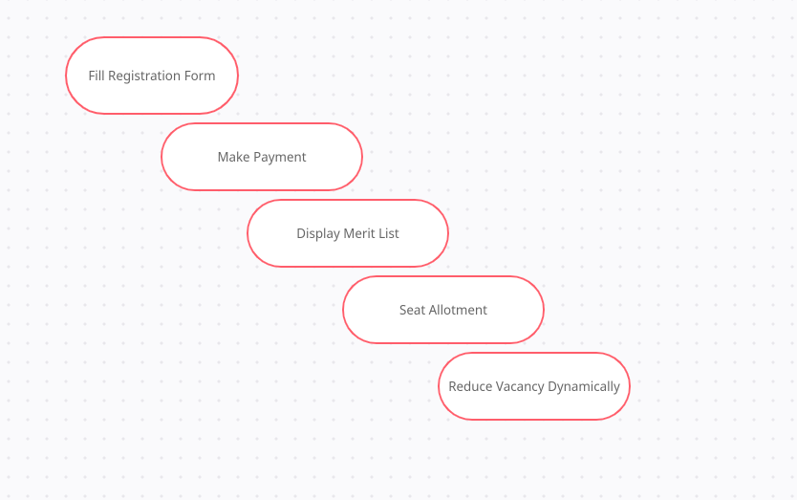
METHODOLOGY

Slide 7
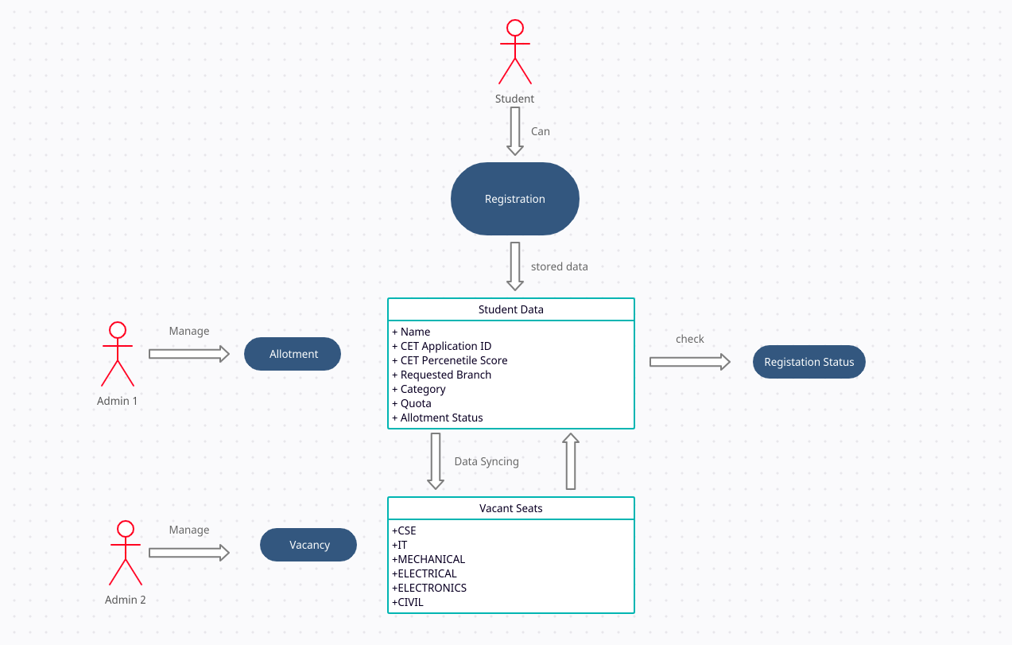
UML/DFD

Slide 8
Outcomes
Digitalized the current manual spot round admission process
Significant reduction in man-hours as well as in time required for the process
Created a REST API for establishing communication between endpoints and to record the requests for future analysis
Successfully designed and implemented Web application for admission process

Slide 9
Technology Stack
Node JS : For backend
React JS: For front end
Razorpay : for payment gateway
MongoDB : for User Data
Express Js: For creating API

Slide 10
Customer Details
Walchand college of Engineering (Primary user)
Any other Engineering college (End user)
Universities (End user)

Slide 11
References
Michel Goossens, Frank Mittelbach, and Alexander Samarin. The LATEX Companion. Addison- Wesley, Reading, Massachusetts, 1993.
Knuth: Computers and Typesetting,
http://www-cs-faculty.stanford.edu/~uno/abcde.html

Slide 12
Thank You

